Slide 1

Vibe coding (AI Coding Assistant Tools)
Omar Abdallah
ommohamed@iti.gov.eg
Hany Saad
hghiett@iti.gov.eg

Slide 2
AI-Powered Coding Assistant Tools
Course Title: AI-Powered Coding Assistant Tools
Duration: 6 Hours ( Lecture + Lab )
Evaluation: Attendance + Task
Prerequisites:
  Intro to Generative AI and Prompt Engineering
  Core Programming Courses

Slide 3
AI-Powered Coding Assistant Tools
Outlines:
  Intro to AI-powered Coding Assistant tools
  Benefits, limitations and security considerations.
  Exploring GitHub Copilot features:
    Code auto-completion, Copilot Chat, , Multi-file edits, Copilot Workspace.
  Overview on another alternatives:
    Cursor, TabNine, …
  Implementing full feature on existing App using GitHub Copilot software agents.

Slide 4
Why do we need to know about Gen-AI?

Slide 5
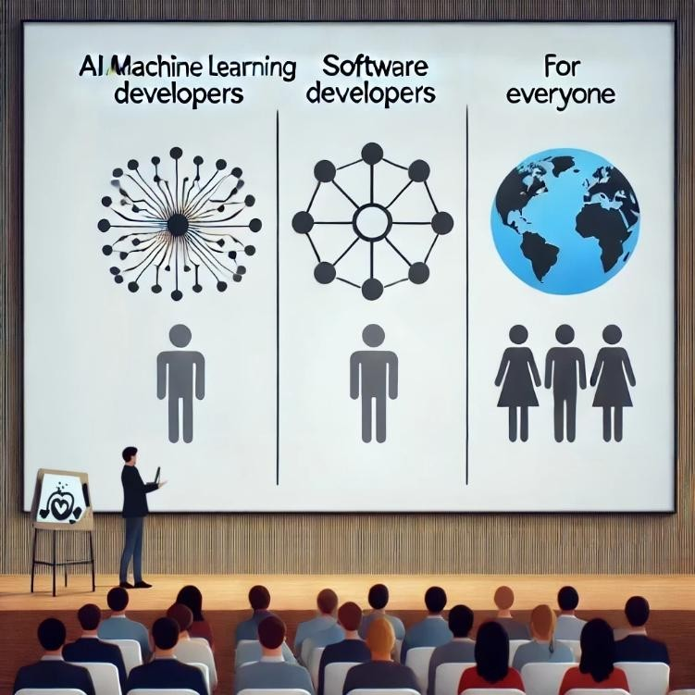
Why should we learn about Gen AI?
AI / Machine Learning Developers:
  Design and refine Generative AI models to create more intelligent and efficient AI-driven solutions.
Software Developers:
  Utilize AI tools to enhance productivity in development tasks.
  Leverage Generative AI APIs to build AI-powered applications
Everyone:
  In today’s AI-centric world, it’s crucial for individuals across all professions to grasp the basics of Generative AI and incorporate AI tools into their workflows to boost productivity.

Slide 6

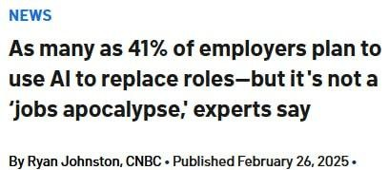
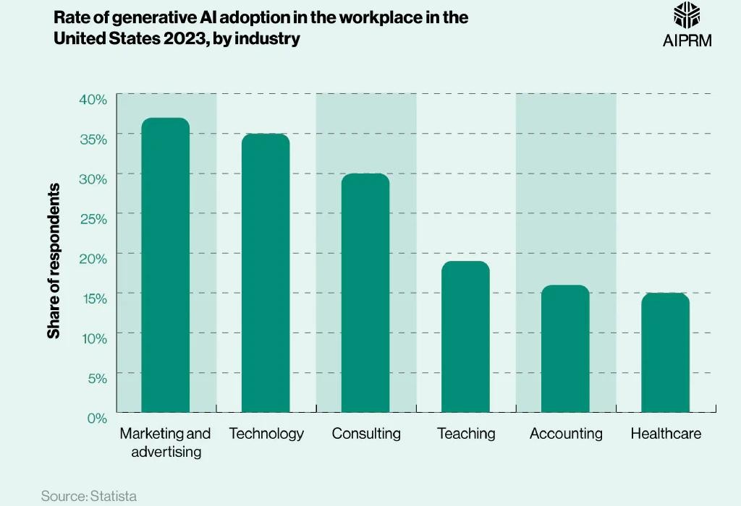
Why should we learn about Gen AI?
Will AI replace jobs / employees ?

Slide 7
Gen-AI based startups and real products
Use cases for real products using Gen AI:
  Loop-x (AI Agents for different roles): https://loop-x.co
  Gemelo ai (Twin AI creator): https://gemelo.ai
  Apriora AI (Recruitment and Interviews): https://www.apriora.ai
  Velents AI (Recruitment and Interviews): https://www.velents.com
  Nancy AI (Recruitment and Interviews): https://nancy-ai.com
  Mariana AI (Medical): https://marianaai.com

Slide 8
How to use the AI tools responsibility?
As a Student / Learner:
  Use AI for asking for explanation, self—testing, researching, and similar activities.
  Don’t Use AI for assignments, projects, or inside topics you’re still learning.
  Build Your Skills to work effectively both with AI and without AI.
In a Job or Freelancing :
  Check First if AI tool usage is permitted and which tools are allowed.
  Use AI to boost productivity and improve your work
  Always review AI-generated content carefully
  Don’t rely on AI for tasks you have no prior knowledge of.

Slide 9
“You write one line — AI writes five back.
You ask a question — it answers with context.
That’s the vibe.”

Slide 10
AI Tools For
Developers

Slide 11
AI-Powered Coding Assistant Tools
What is an AI Coding Assistant Tool?
  AI Coding Assistant tools are software tools or IDE extensions that leverage artificial intelligence to assist developers in writing, understanding, and improving the code.
Key Capabilities:
  Code Suggestions and Auto-completion: Offers real-time suggestions for completing code blocks, reducing manual typing.
  Error Detection and Fixes: Identifies potential errors or bugs and suggests solutions or fixes automatically.
  Code Generation: Can generate entire code snippets or functions based on prompts or comments.
  Code Refactoring: Helps improve the structure of existing code for better performance or readability.
  Documentation Support: Generates or improves comments and documentation based on the code context.

Slide 12
AI-Powered Coding Assistant Tools
Top AI Coding Assistant Tools:
  GitHub Copilot
  Gemini Code Assistant
  Cursor AI
  Replit Ghostwriter
  Codium AI
  TabNine
  Lovable
  N8n
  … and more

Slide 13
What’s GitHub Copilot
GitHub Copilot is a cloud-based AI pair programming tool developed by GitHub and Open AI based on OpenAI codex model to autocomplete and suggest code and entire functions for faster development, It could also generate code from scratch from a well documented code comments.
GitHub Copilot integrates directly into your editor including Neovim, JetBrains IDEs, Visual Studio, and Visual Studio Code.
GitHub Copilot provides suggestions for numerous languages and a wide variety of frameworks, but works especially well for Python, JavaScript, TypeScript, Ruby, Go, C#, and C++.
GitHub Copilot History:
On June 29, 2021, GitHub announced GitHub Copilot for technical preview in the Visual Studio Code development environment. GitHub announced Copilot's availability for the Visual Studio 2022 IDE on March 29, 2022. On June 21, 2022, GitHub announced that Copilot was out of "technical preview" and is available as a subscription-based service for individual developers.

Slide 14

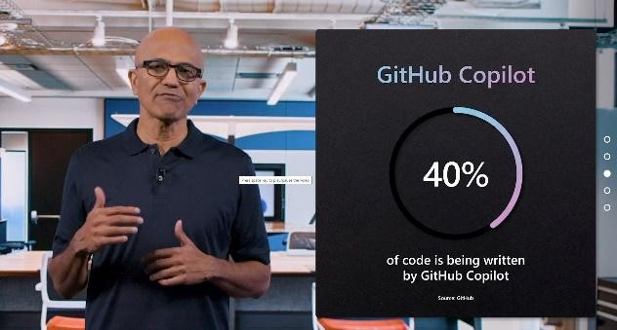
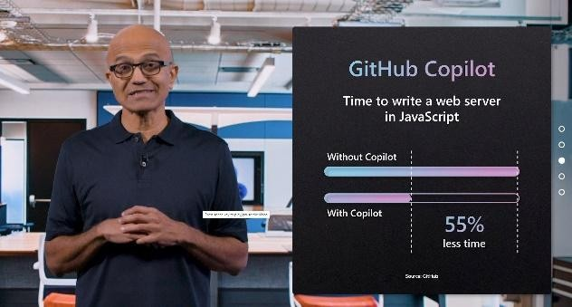
What’s GitHub Copilot
GitHub Copilot is a cloud-based AI pair programming tool developed by GitHub and Open AI based on OpenAI codex model to autocomplete and suggest code and entire functions for faster development, It could also generate code from scratch from a well documented code comments.
GitHub Copilot integrates directly into your editor including Neovim, JetBrains IDEs, Visual Studio, and Visual Studio Code.
GitHub Copilot provides suggestions for numerous languages and a wide variety of frameworks, but works especially well for Python, JavaScript, TypeScript, Ruby, Go, C#, and C++.
GitHub Copilot History:
On June 29, 2021, GitHub announced GitHub Copilot for technical preview in the Visual Studio Code development environment. GitHub announced Copilot's availability for the Visual Studio 2022 IDE on March 29, 2022. On June 21, 2022, GitHub announced that Copilot was out of "technical preview" and is available as a subscription-based service for individual developers.

Slide 15
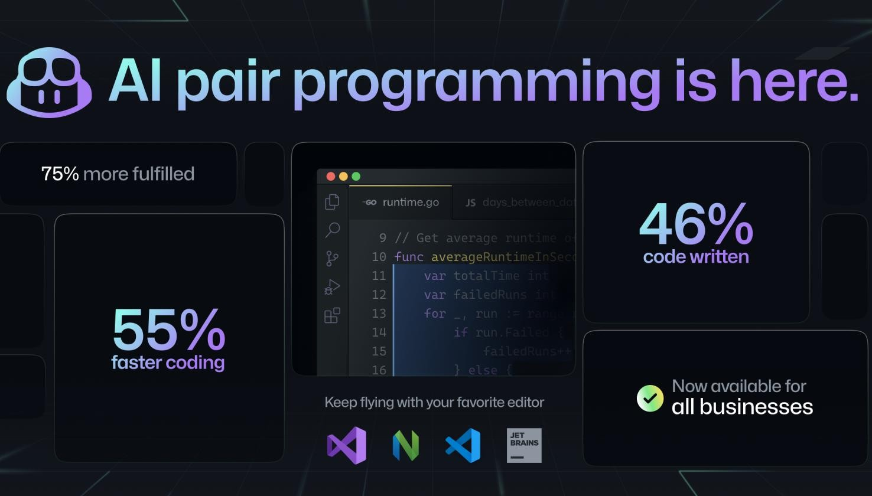
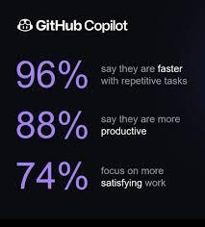
What’s GitHub Copilot

Slide 16
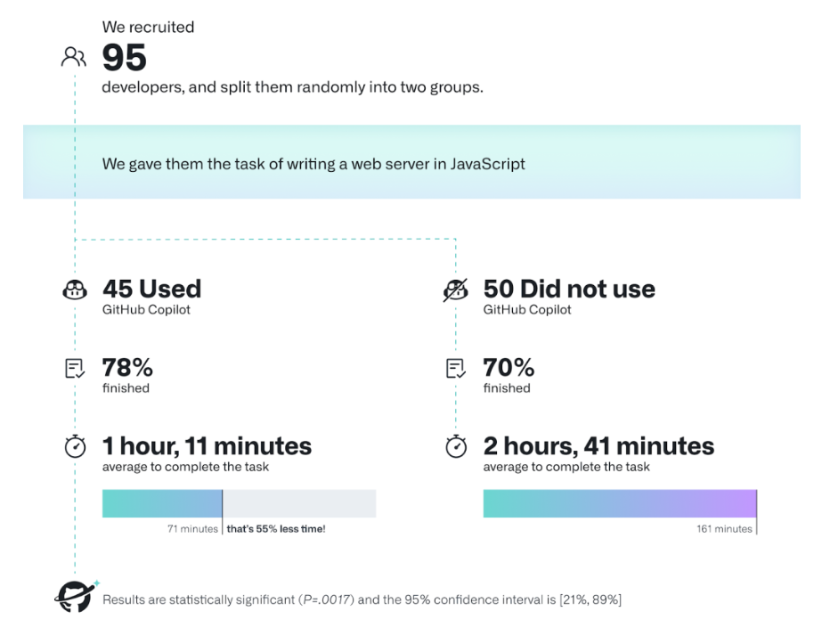
What’s GitHub Copilot

Slide 17
GitHub Copilot Use Cases
Code generation and suggestions
Unit test generation
Code reviews and refactoring
Bug fixing
Generating code documentation and explaining code
Generating SQL queries
GitHub Copilot Chat
Cloud deployment guidance and troubleshooting (e.g., Azure, AWS)
Automating CI/CD pipeline tasks
Optimizing code performance
Command-line tool assistance
Pull request summaries
Managing and interacting with cloud resources (e.g., Azure services)
Translating code between programming languages
Enhancing security by identifying vulnerabilities
Auto-generating comments and annotations
Writing configuration files (e.g., YAML, JSON, Dockerfiles)
Automating repetitive tasks (e.g., regex creation, cron jobs)
Real-time feedback on coding best practices
Knowledge base querying for organization-specific documentation

Slide 18
GitHub Copilot Features
Code Completion: GitHub Copilot provides context-aware, autocomplete-style code suggestions in popular IDEs such as Visual Studio Code, Visual Studio, JetBrains IDEs, Azure Data Studio, and Vim/Neovim.
Copilot Chat: This feature allows you to interact with Copilot via a chat interface. It is available in supported IDEs (Visual Studio Code, Visual Studio, and JetBrains IDEs), on GitHub.com, and in GitHub Mobile. It supports natural language queries for code explanations, debugging help, translating between programming languages, and more. Copilot Chat is powered by GPT-4 and can assist with context-specific coding scenarios​.
Copilot for the Command Line (CLI): This feature extends Copilot's assistance to the terminal. You can use commands like gh copilot suggest to get command recommendations or gh copilot explain to get explanations of commands. This feature also supports creating command aliases and executing suggested commands directly from the terminal.
GitHub Copilot Extensions (Beta): provide developers with enhanced AI-assisted capabilities tailored to specific workflows or environments. These extensions integrate directly into popular development platforms and tools, offering greater flexibility and customization for coding tasks

Slide 19
GitHub Copilot Features (Cont.)
GitHub Copilot for Azure (Beta): is a specialized extension that integrates GitHub Copilot's AI-powered coding assistance with Azure services. It acts as a cloud coding companion that helps developers interact with Azure resources directly from their IDE, enhancing productivity and reducing the complexity of cloud development.
Copilot in GitHub.com: Integrates directly into the platform for users subscribed to Copilot Individual or Business plans. This allows developers to harness AI directly in their browser without needing to switch to an IDE.
Pull Requests Summaries: (Enterprise Only): Copilot can automatically generate summaries of pull requests, highlighting changes, their impact on files, and areas of interest for reviewers. This feature saves time during code reviews​.
GitHub Copilot workspace: development environment that helps developers plan, write, and test code using natural language. It supports multi-file changes, integrates with GitHub Code spaces, and allows real-time editing and debugging for seamless collaboration.
Text Completion (Enterprise Only): Copilot also assists with natural language tasks, such as generating text descriptions for pull requests and other documentation​.
Knowledge Bases (Enterprise Only): This feature allows users to create collections of documentation that can be used as a reference for Copilot Chat, enabling more informed answers​.

Slide 20
GitHub Copilot Features (Cont.)
Slash Commands
  Take advantage of Copilot's slash commands such as /fix, /explain, /doc, and /tests for common development tasks.
  These commands allow you to quickly fix code, generate explanations, create documentation, and write unit tests.
  Examples:
    /fix: Proposes a fix for selected code.
    /explain: Provides a detailed explanation of the selected code.
    /doc: Generates documentation for the code.
    /tests: Creates unit tests for the selected code.
Chat Participants (@ Operator)
  Use @workspace to instruct Copilot to consider your entire project when responding. This ensures Copilot.
  Leverages all open files and configurations in the workspace.
  Other participants like @terminal help Copilot assist with terminal-related tasks, including shell commands.

Slide 21
GitHub Copilot Features (Cont.)
File and Section References (# Operator)
  Reference specific files, classes, or methods using the #file or #method syntax. This helps Copilot focus on particular sections of your code and improves accuracy.
  Examples:
    #BasketService.cs: Points Copilot to a specific file..
    #AddItemToBasket: Directs Copilot to a particular method.
Inline chat
  Press CMD+I (or CTRL+I on Windows) to bring up inline chat directly within your code.
  Ask questions, get explanations, or generate code snippets without leaving your current workflow. Inline chat provides context-aware suggestions based on the code you're working on.

Slide 22
Thank You
https://www.linkedin.com/in/omar-abdallah-abdelrahman/

